Slide 1
Kick-off presentation
Johanna Schaefer

Slide 2
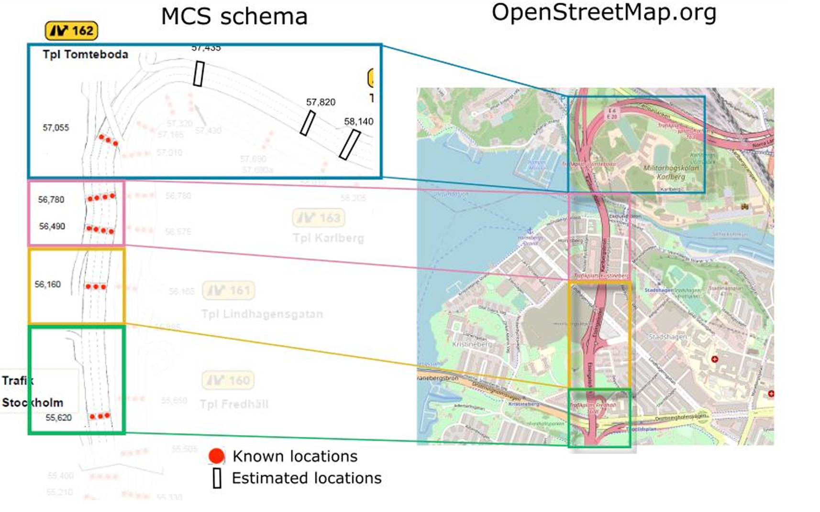
Research question
Project topic 2: short-term traffic prediction
How well can missing sensors be compensated by using data from other sensors in the same portal or from neighboring?

Slide 3
Research question
How well can missing sensors be compensated by using data from other sensors in the same portal or from neighboring?
→regression problem
Hypothesis: Sensors in the same portal are better at forecasting than sensors in a different portal.
Practical relevance: Sensor failures are common in real-world traffic systems.

Slide 4
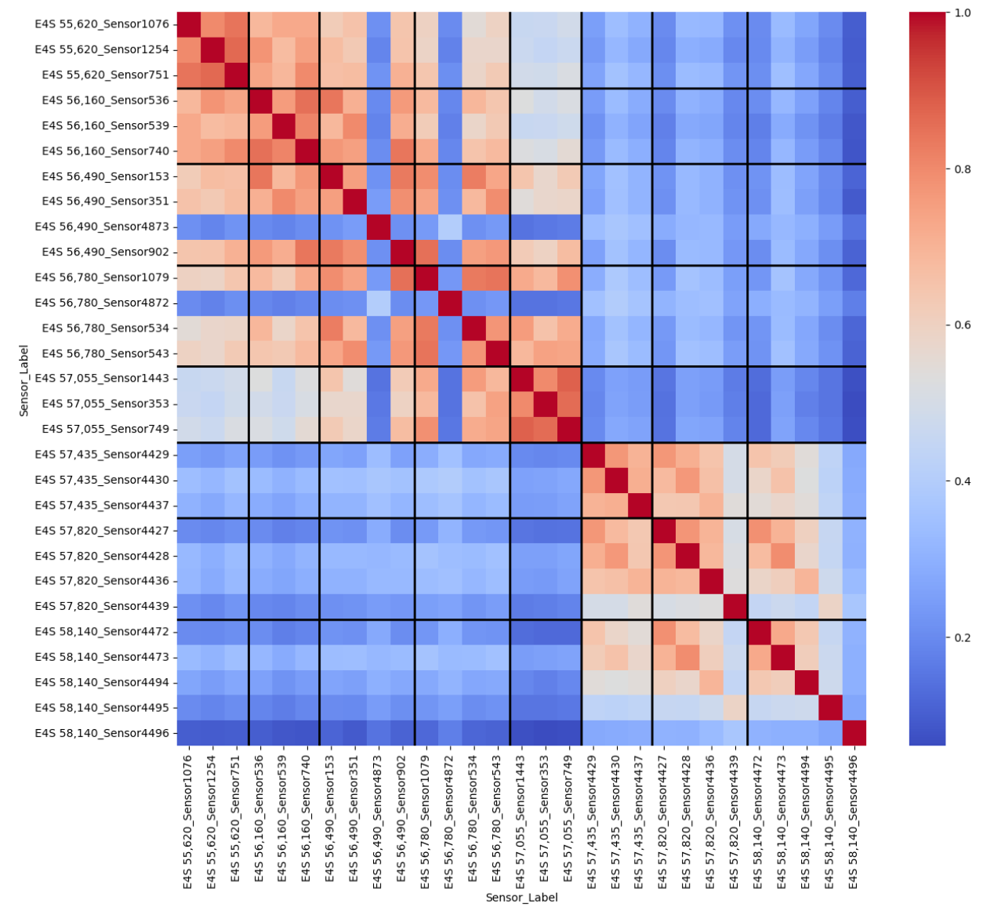
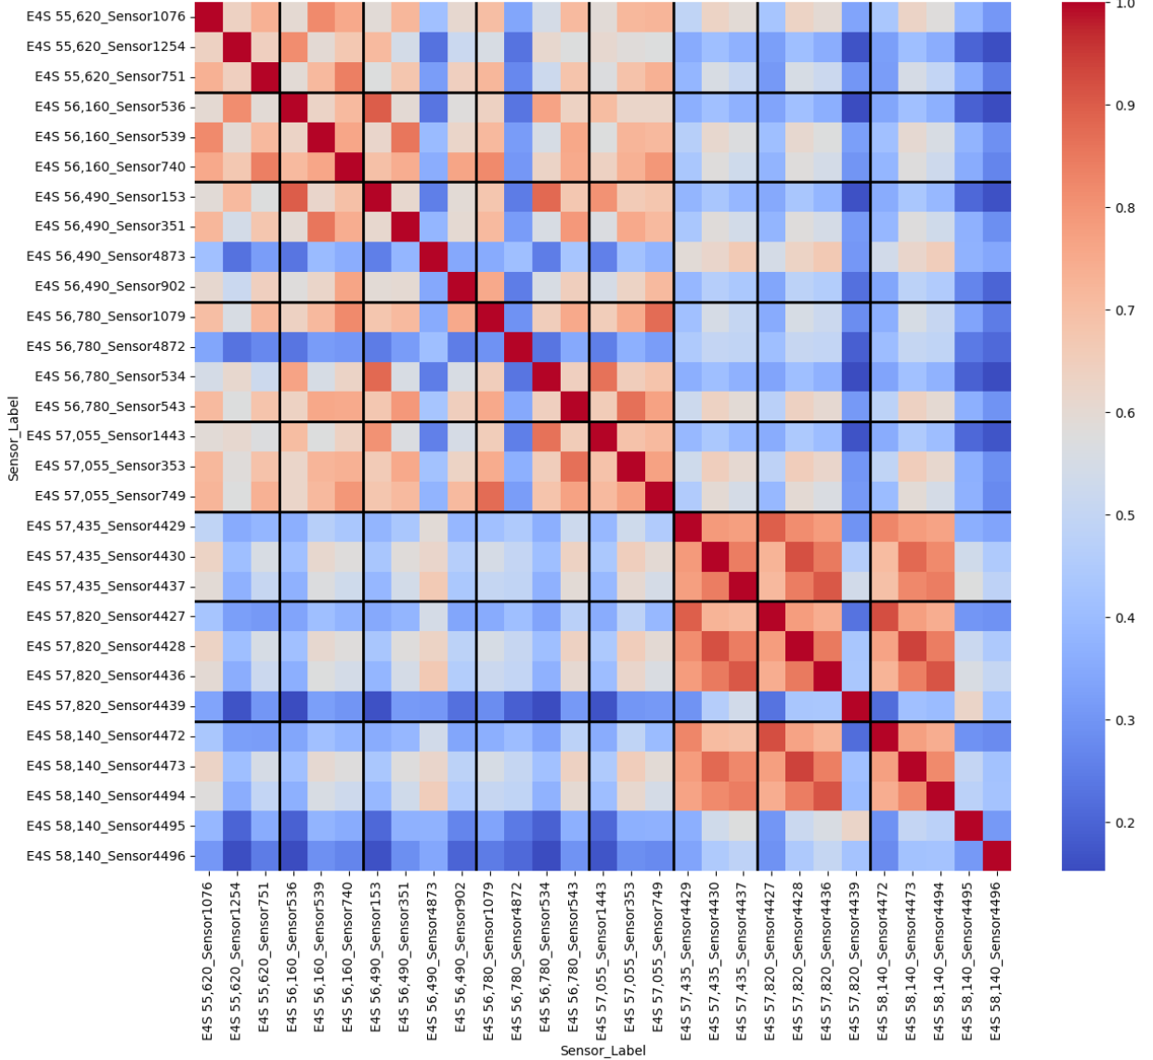
Start of descriptive analysis
Speed
Flow

Slide 5
Data
Start with one sensor (e.g. sensor 1076) and try to predict the traffic
with the other sensors in the same portal (55620)
the sensors in the portal upstream (56160)
Potentially enlarge it to other sensors

Slide 6
Validation experiment plan
Continue descriptive analysis (temporal & spatial correlations)
Split experiments: predict from same-portal vs. neighbouring-portal sensors
Start with speed prediction (smoother), later extend to flow
Train/test with multiple model types from class
Evaluate final two models (same portal, neighbouring portal) on held-out evaluation set

Slide 7
Remaining questions
Is there a way to find out which sensor corresponds to which lane?
Is the location of the sensors known? (for time decay)
what is the difference between the known and the estimated locations?
Can we choose one sensor to do predictions for? Or are we supposed to do predictions for all of them?
Do we develop one model or several?

